Slide 1
Big Data Project Team-16
Team Members
Gaurav
Saif
Sharmistha
Shashank

Slide 2

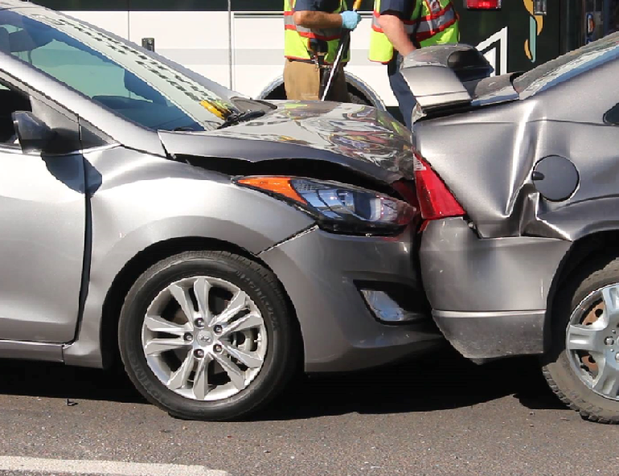
Goal
Multiple factors affect the pricing of auto insurance policies.
To reduce the loss of an auto insurance company via an analysis of natural logarithmic of loss ratio using predictive modeling.

Slide 3
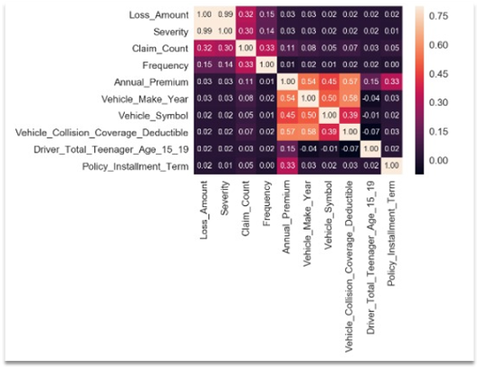
Data Preparation
One Hot Encoding: Convert Categorical variables into numerical values.
Correlation Analysis: Statistical technique to show relationship between variables.
Missing Values and Outliers: Used nearest neighbor method for similar features and scale down the outliers.

Slide 4
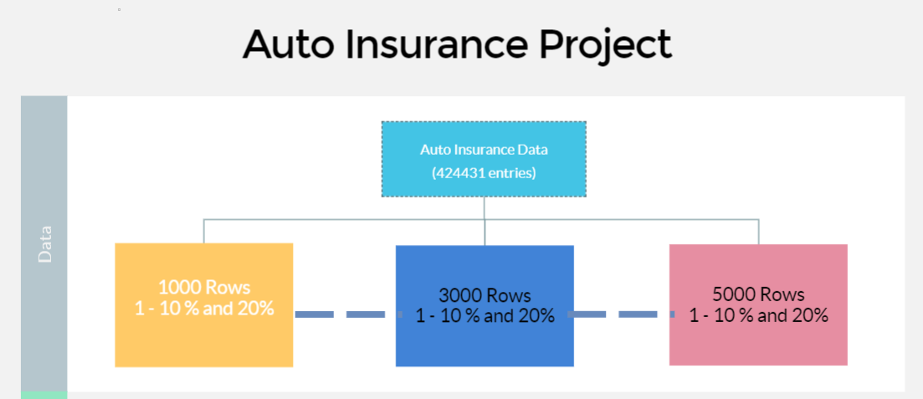
Sampling
We have taken min and max for attributes, Policy installment term and vehicle symbol.
Used sum function for the loss amount attribute.
Calculate the mean for Installment Policy column.

Slide 5
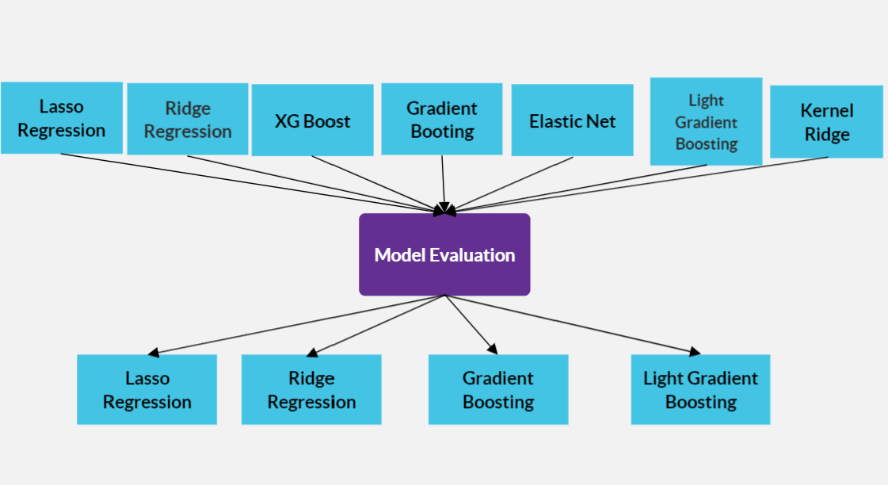
Training Split and Model Selection
Aggregated 330 portfolios into 330 rows.
Initially we selected seven models, but after evaluation we dropped three models.
Cross Validation has been applied on all four models while training.

Slide 6
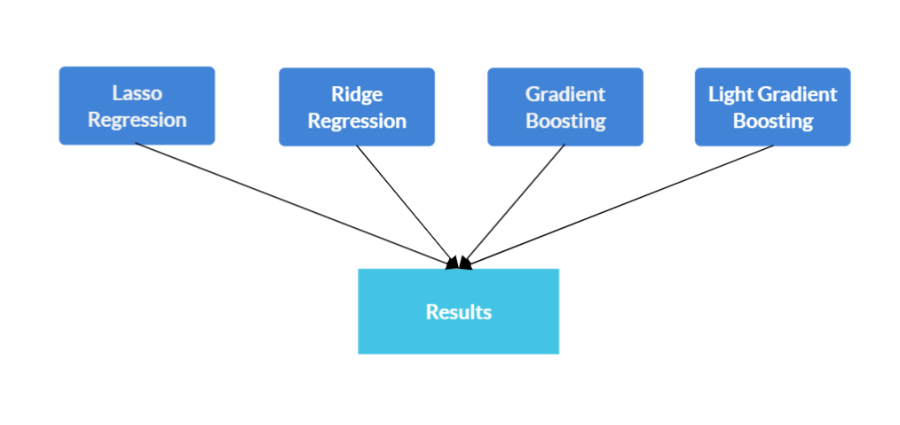
Prediction Modeling
We used gradient algorithms and regression algorithms based on the conditions
We took the average from all the results, respectively.
Automated all the procedures before getting predictions

Slide 7
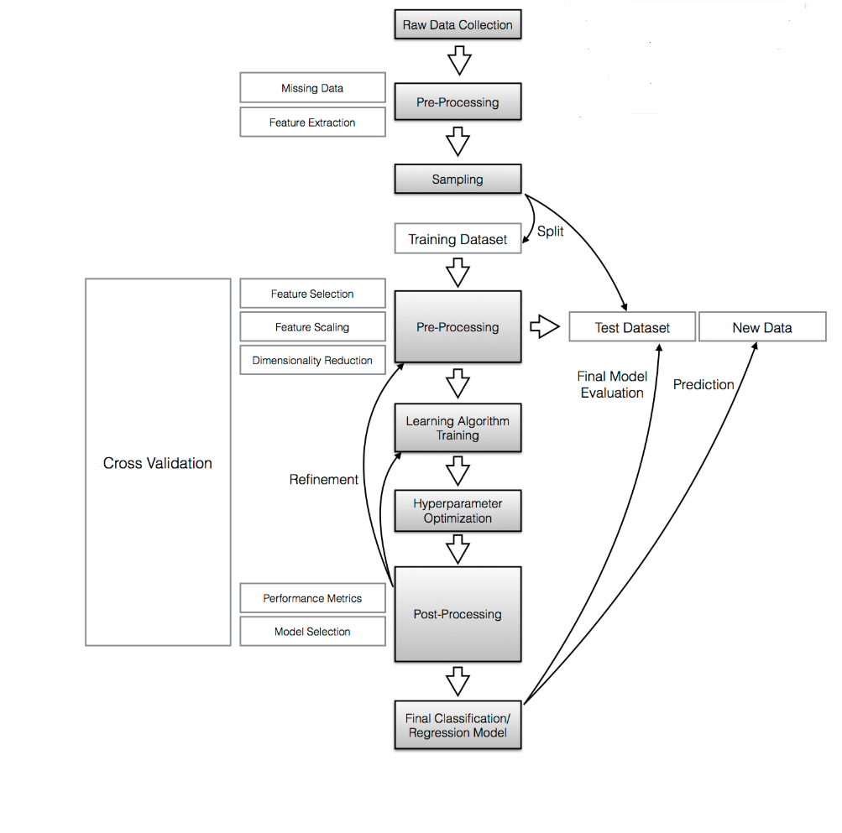

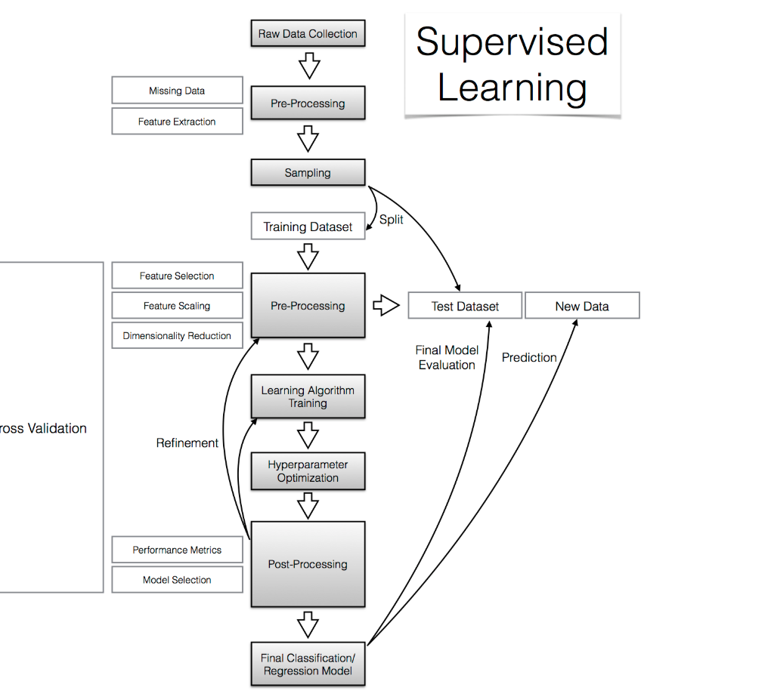



Predictive Modeling

Slide 8
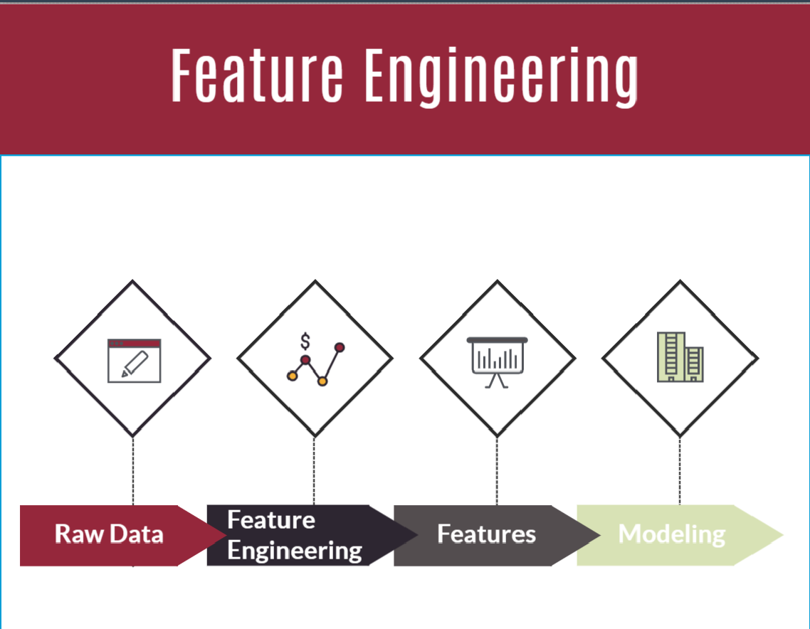
Feature Engineering
Infuse Domain Knowledge
Decide on features
Create features
Checking features with the model
Improving on the features

Slide 9
Thank You

Slide 10
The Problem we are solving
The data provided

Slide 11
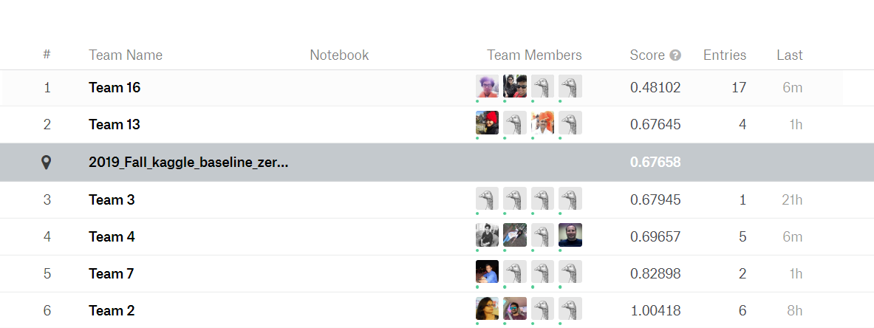
Leaderboard as of 11/

Slide 12
Supervised Learning
Prediction of future cases
Knowledge Extraction
Compression
Outlier Detection

Slide 13

Data Structuring
Data structuring deals with analyzing the nature of data and its importance in the larger scheme of things.
Breakdown data into further sub-categories to better suit our strategy.
The data which are not significant are discarded.
Convert the categorical variables into 0's and 1's using One Hot Encoding.
Create training samples from the structured data

Slide 14
Data Preprocessing
Rescale Data
Binarize Data
Standardize Data

Slide 15
Correlation Matrix
The correlation matrix displays the top ten features selected after structuring our data.
The correlation matrix shows correlation coefficients between two variables which is used to summarize data.

Slide 16
Training Samples
The training dataset is used initially to the fit and tune the models.
The training dataset is the actual dataset that is used to train the model and check its performance for different modelling techniques.
Divide the data into chunks of 500, 1000 and 3000 rows, including loss ratios varying from 1% to 10 % and 20% for all the chunks of data.
Compress the values of these partitioned data into a single column.

Slide 17
Calculating the Loss Ratio
The Loss ratio in terms of auto insurance industry is defined as the ratio of the total losses paid out by an insurance company on claims received divided by the total premiums earned by the insurance company.
The target value of the project is "natural log of portfolio loss ratio", which is calculated using the formula
IN_LR = ln(TOTALLosses / TOTALPremium)
The expected loss ratio can be used to determine the estimated losses for each individual policies.

Slide 18
Modelling Techniques
It is always a good practice to test out different models to find the best fit for the data we are working with.
Multiple modeling techniques are used to train the data. We check the performance of all the techniques, compare their output and take average of the results.
We have used seven modelling techniques namely Linear Regression, Lasso Regression (L1), Ridge Regression (L2), XG Boost, ElasticNetCV, LightGBM and GridSearchCV.
Use the test data set to check the unbiased performance of the final model fit on the training data set.

Slide 19
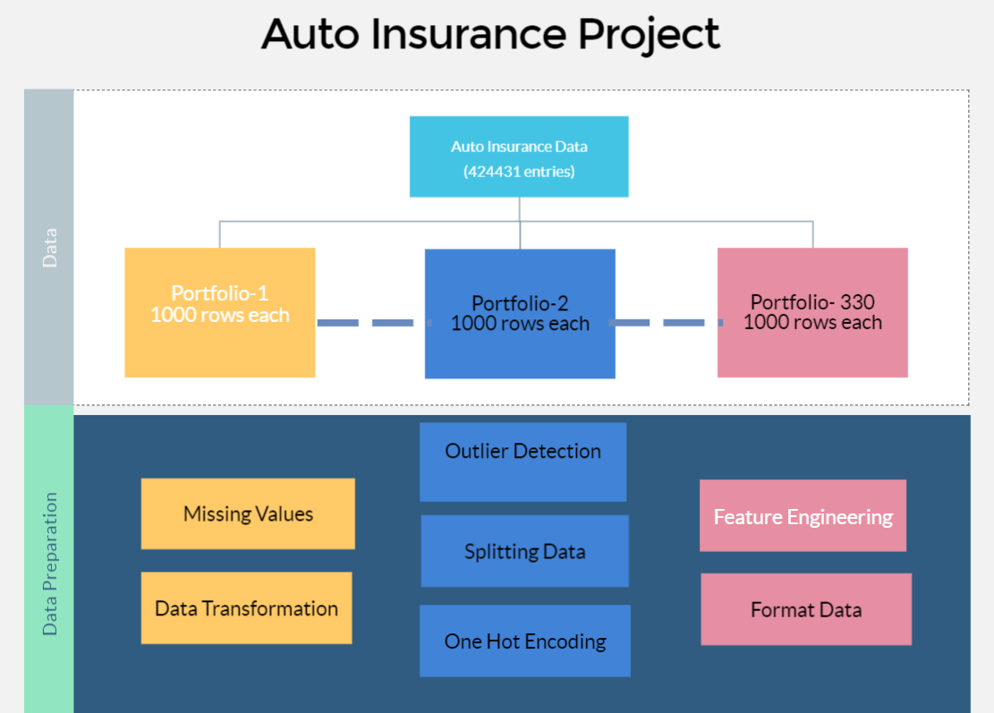

Slide 20
Important features for Predicting Loss ratio
Annual Premium
Vehicle make year
Vehicle usage
Vehicle symbol
Number of drivers
Vehicle performance
Miles to work
Vehicle Age
Total drivers
Drivers Age

Slide 21
Business Process and Features on Predictive modeling
Business Process and Feature Modeling:
Creating the model
Testing the model
Validating the model
Evaluating the model
Statistics
Data Analysis and manipulation
Visualization

Slide 23
Sampling
Policy installment term and vehicle symbol – min max
Loss amount (sum)
Installment policy (mean)
For continuous variables we have created buckets and labeled them. Where each values will fit into a particular bucket
Cross Validation in L1 and L2

